Slide 1






‘Every place has a story for you. Every moment has an experience for you’
– Telangana Tourism
Insights to Telangana Government Tourism Department
Domain: Tourism | Function: Revenue / Municipal Administration
Presentation by : Madhupa Samanta
Data Analyst

Slide 2
Table of Contents
01
02
Telangana Map with tourist places
Fact Sheet
03
04
Analyzing the growth of tourist arrivals district wise by answering some questions provided
Recommendations to
Boost tourism

Slide 3
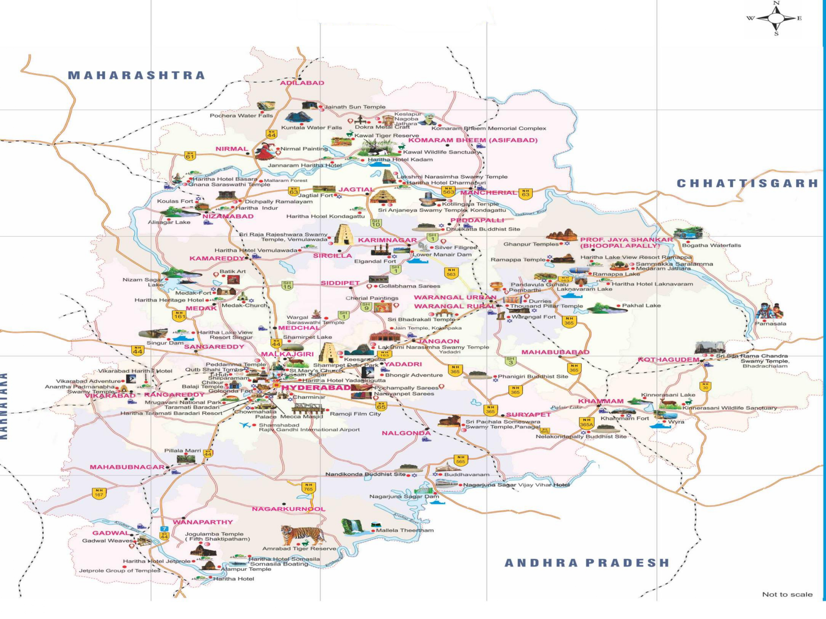
TELANGANA MAP

Slide 4

FACT SHEET
Capital : Hyderabad
Grographical Area (sq km) : 114840
Districts : Total 33 districts
Major Cities : Hyderabad, Secunderabad, Warangal
State Language : Telegu, English, Hindi
Climate : Winter (November to February) Summer (March to June, peak in May with avg 42 deg celcius) Monsoon (July to September)
Key Industries : IT, Pharmaceutical, Manufacturing, Textile, Tourism, Mines and Minerals

Slide 5
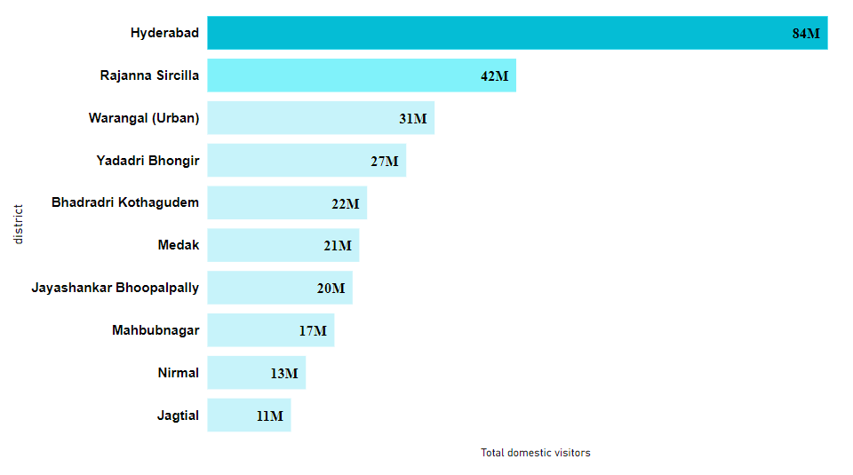
Q1. List down Top 10 districts having highest number of domestic visitors from 2016 to 2019
Hyderabad received the most domestic visitors(84 M) in Telangana
From 2016 to 2019, Hyderabad got 23.55 % of total domestic visitors, followed by Rajanna Sircilla and Warangal(Urban).

Slide 6
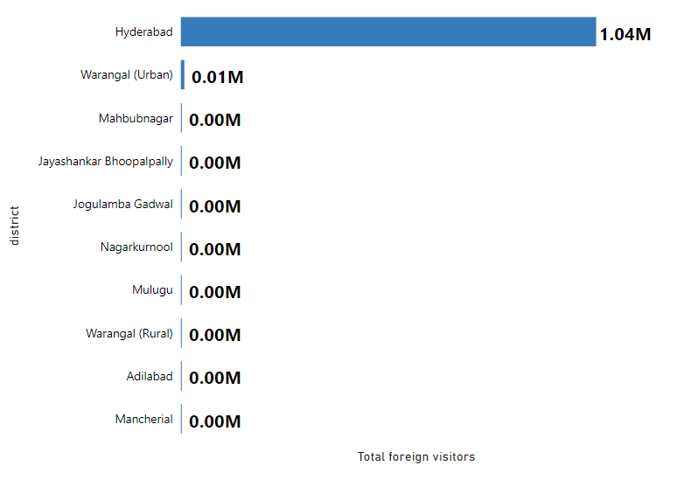
Top 10 districts having highest number of foreign visitors from 2016 to 2019 :
Hyderabad also received the highest foreign visitors(1.04 M) in Telangana
Hyderabad got 98.58 % of total foreign visitors in Telangana from 2016 to 2019 .
The second highest district Warangal(Urban) got only 8828 foreign visitors and Mancherial, the last one among top 10, received only 10 foreign visitors in these 3 years .

Slide 7

Insights
Out of all districts, Hyderabad is the top destination for both domestic and foreign visitors.
In addition to Hyderabad, Warangal(Urban), the second-fastest growing city in Telangana, is also experiencing a high influx of domestic and foreign tourists.
With the exception of Hyderabad and Warangal, the remaining districts in Telangana is attracting minimal foreign tourists.

Slide 8
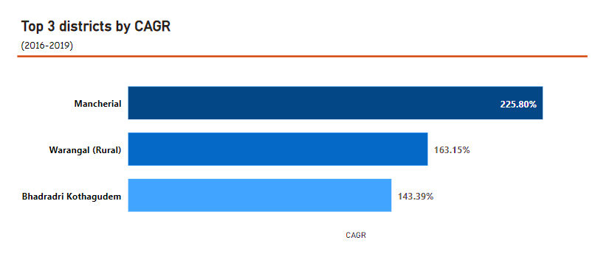
Q2. List top 3 districts based on CAGR of visitors from 2016 to 2019
Mancherial district has the highest CAGR of visitors(225.80%) during this period, that means the number of visitors to Mancherial has grown at a faster rate compared to other districts.
The reasons behind this could be diverse, such as improved infrastructure, increased tourism promotion, and better accessibility.

Slide 9
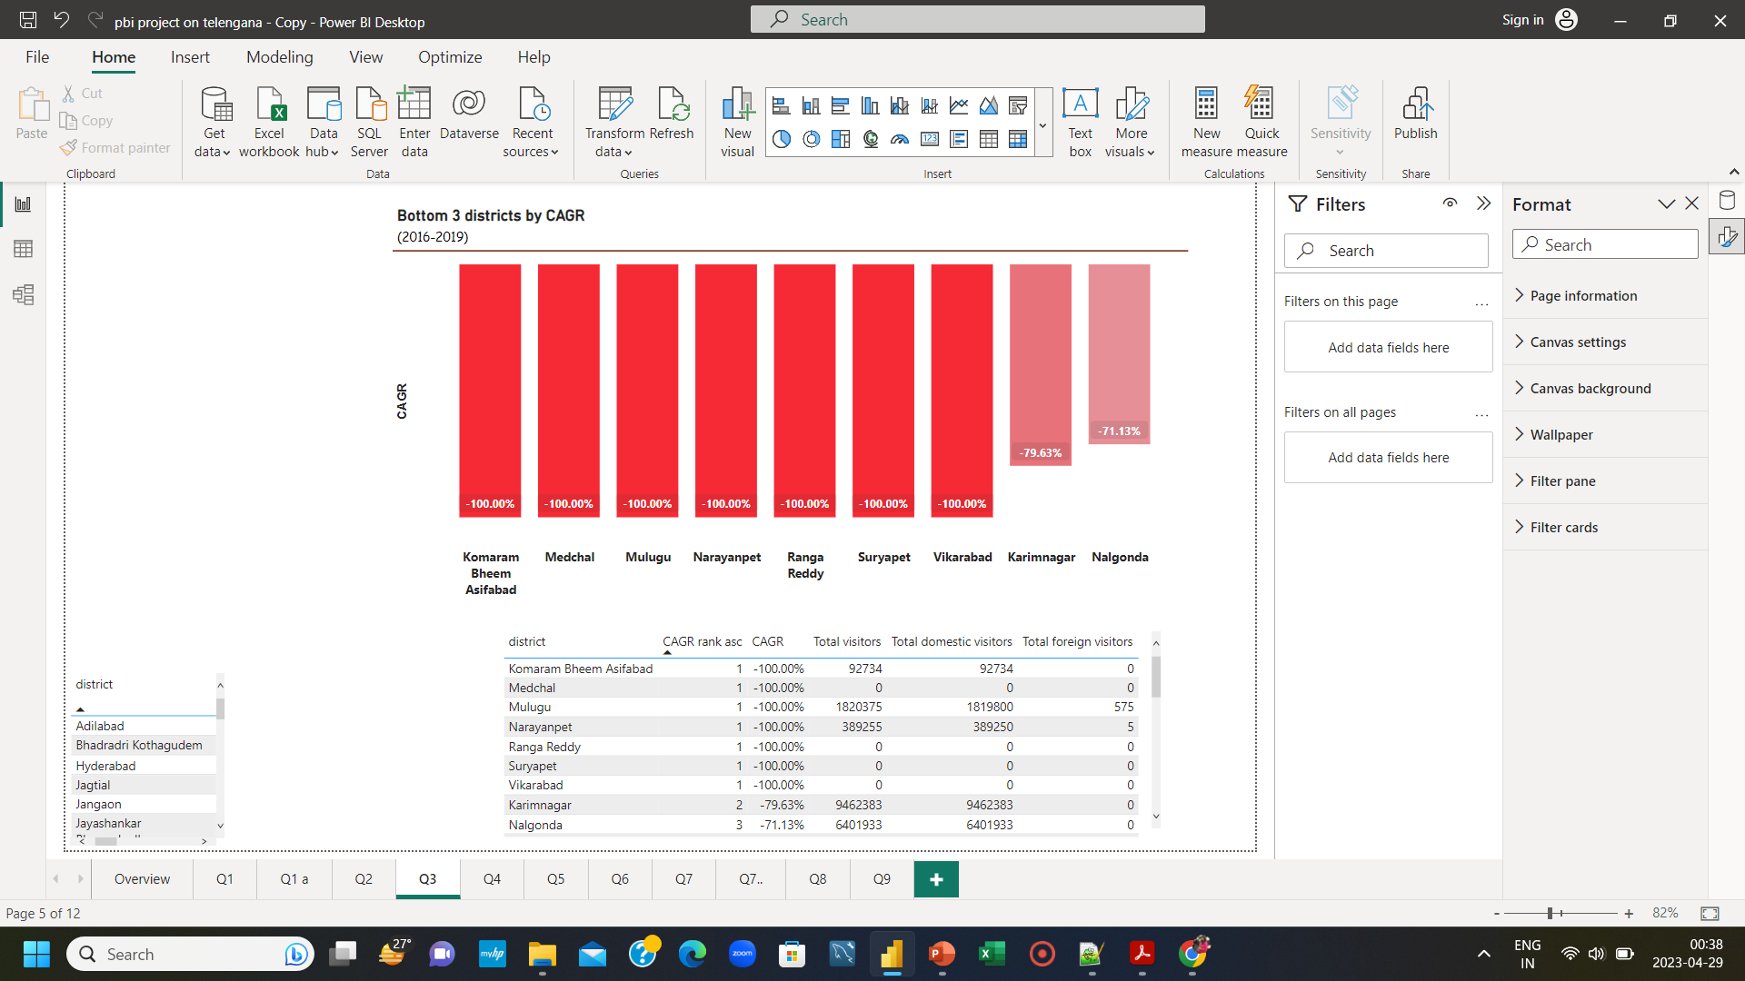
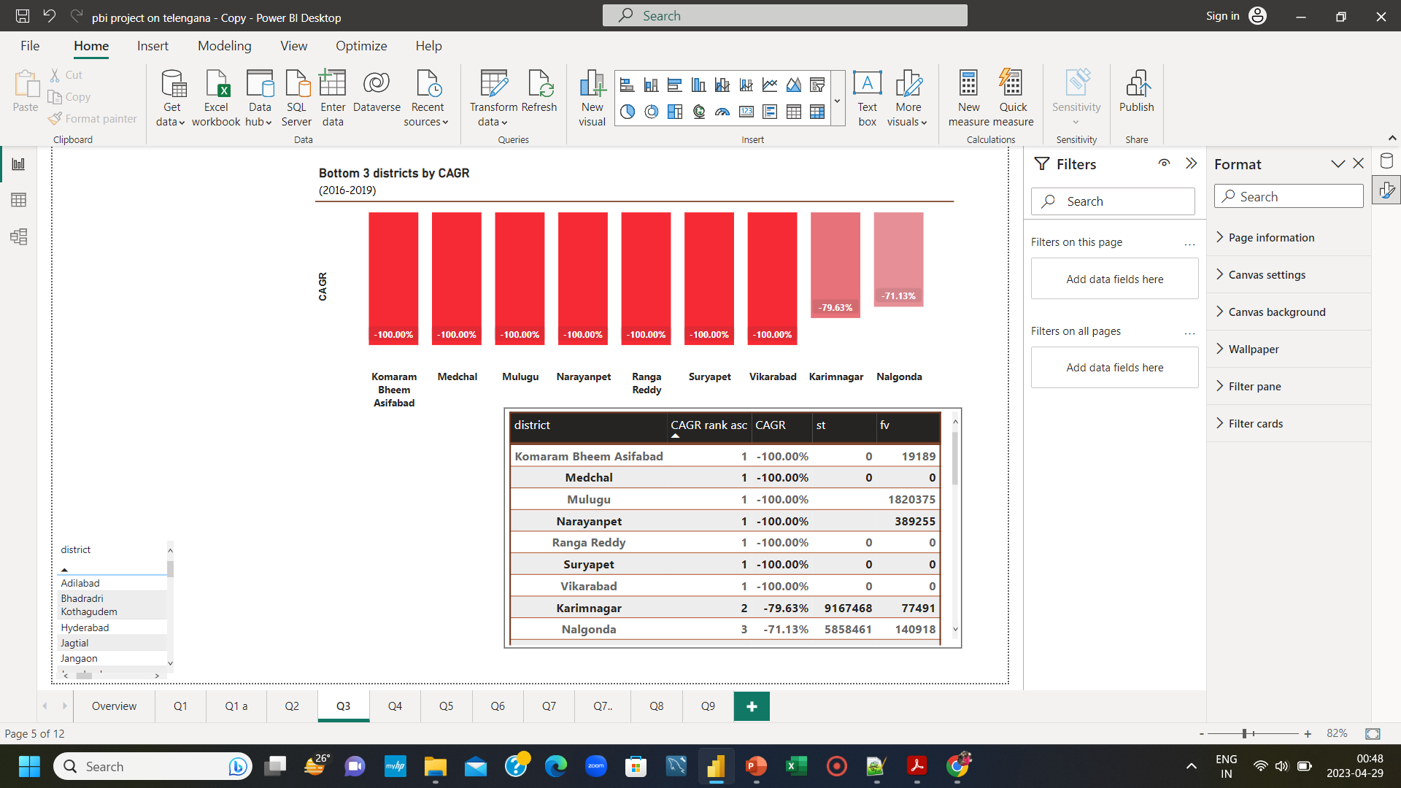
Q3. List bottom 3 districts based on CAGR of visitors from 2016 to 2019
Insights
Due to lack of available data, CAGR is negative for the districts Komaram Bheem Asifabad, Medchal, Mulugu, Narayanpet, Ranga Reddy, Suryapet, Vikarabad.
According to the CAGR (Compound Annual Growth Rate) data from 2016 to 2019, Karimnagar and Nalgonda districts have recorded the lowest growth rates in terms of visitors, and ranked as the second lowest and third lowest districts, respectively.
St – > Total visitors in 2016
fv – > Total visitors in 2019

Slide 10
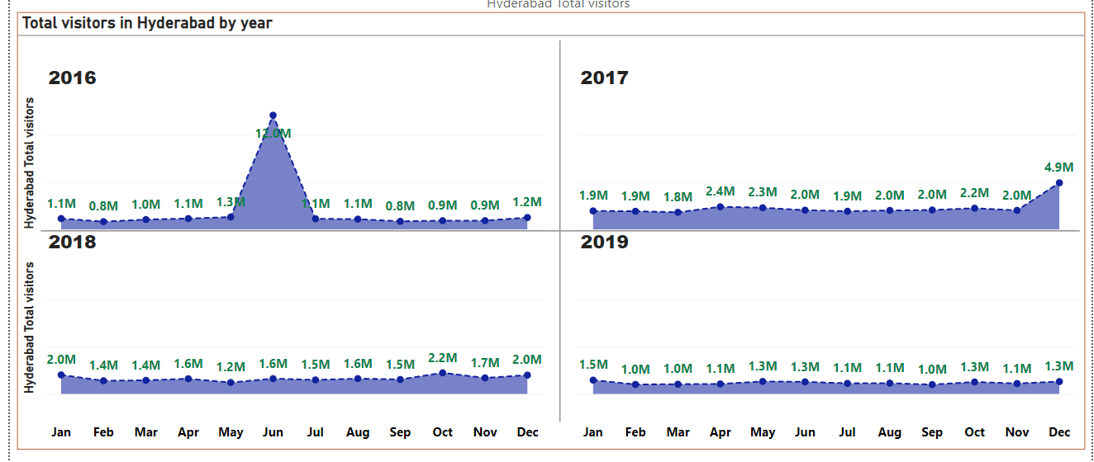
Q4. Find pick and low seasons for Hyderabad baaed on data from 2016 to 2019
Peak seasons : Dec, Jan, May, Jun
Low seasons : Feb, Mar, Jul to Sept(Monsoon)

Slide 11
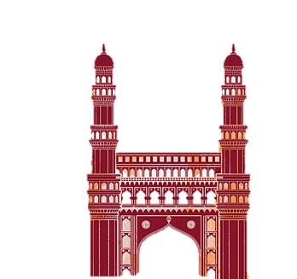



Suggestions to boost tourism in Hyderabad in low seasons :
Promoting Off-Season Tourism:
The government can promote the city's unique features that are available during the off-season, such
as the city's historic monuments, museums, and cultural events.
Special Deals and Packages:
The government can collaborate with local tour operators and hotels to offer special deals and
packages with discounted rates during the low season months.
Event and Festival Planning:
The government can plan events and festivals during winter(Feb, Mar) to attract visitors. For example,
Art festival to showcase Hyderabad’s rich cultural heritage.
Food festival featuring Hyderabad’s famous street foods, traditional foods, local delicacies.
Craft Fair and shopping festivals to showcase its traditional handicrafts, textiles, and jewelry.
Infrastructure Development:
The government can invest in infrastructure development like improving transports, developing new
tourist trails to enhance the visitor experience during the off-season.

Slide 12
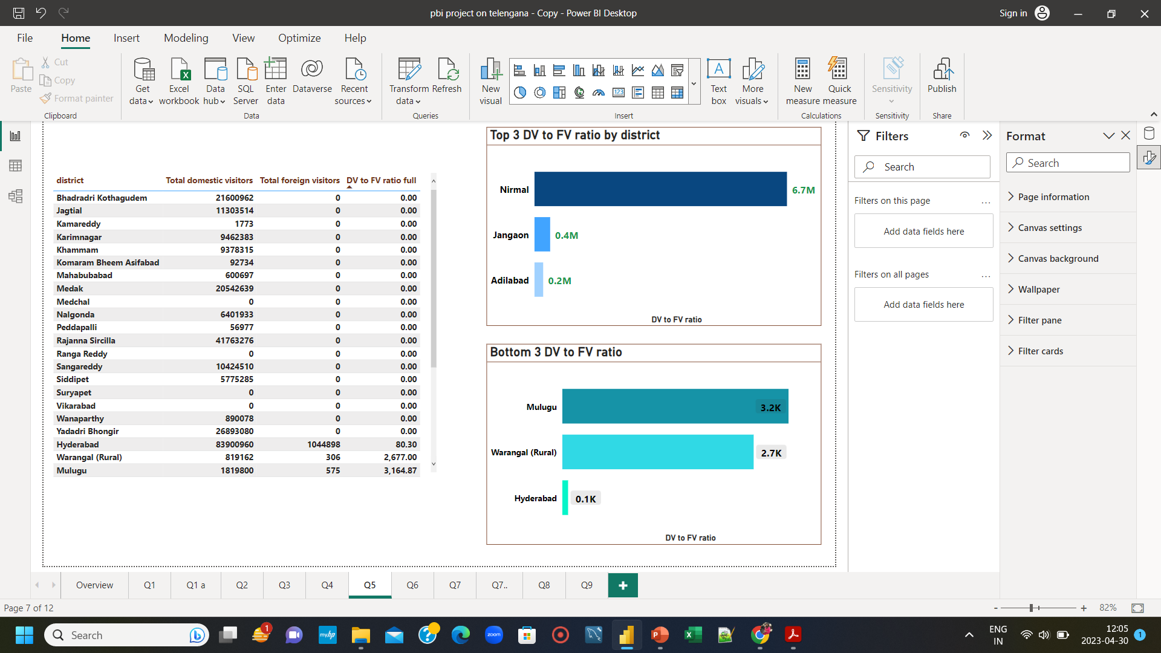
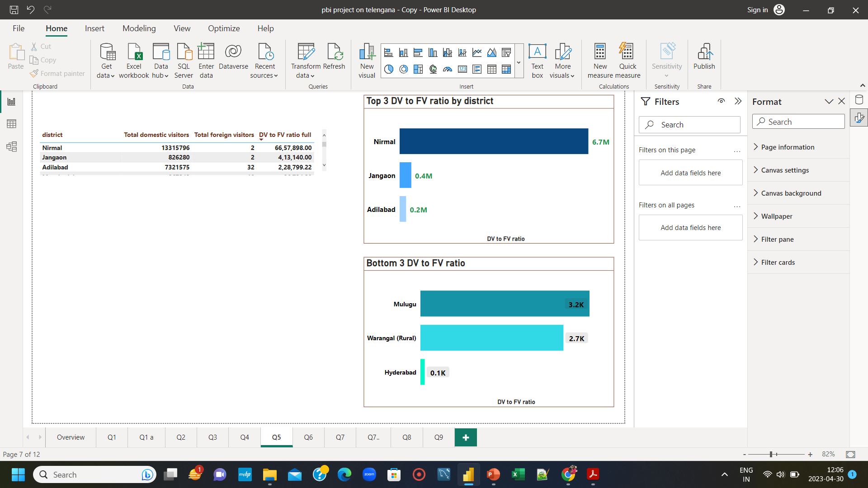
Q5. Show top and bottom 3 districts with high domestic to foreign tourists ratio .
Mulugu, Warangal(rural) and Hyderabad are popular among both domestic and foreign visitors with Hyderabad getting the most foreign visitors from 2016 to 2019.
Nirmal is most popular district among Indian tourists with minimal foreign tourists.
This place is well recognised internationally for home to the exclusive wooden toys(NIRMAL TOY). Also this place has great network of roadways with NH 44 crisscrossing this districts.
So government can promote that to bring more foreign tourists.

Slide 13
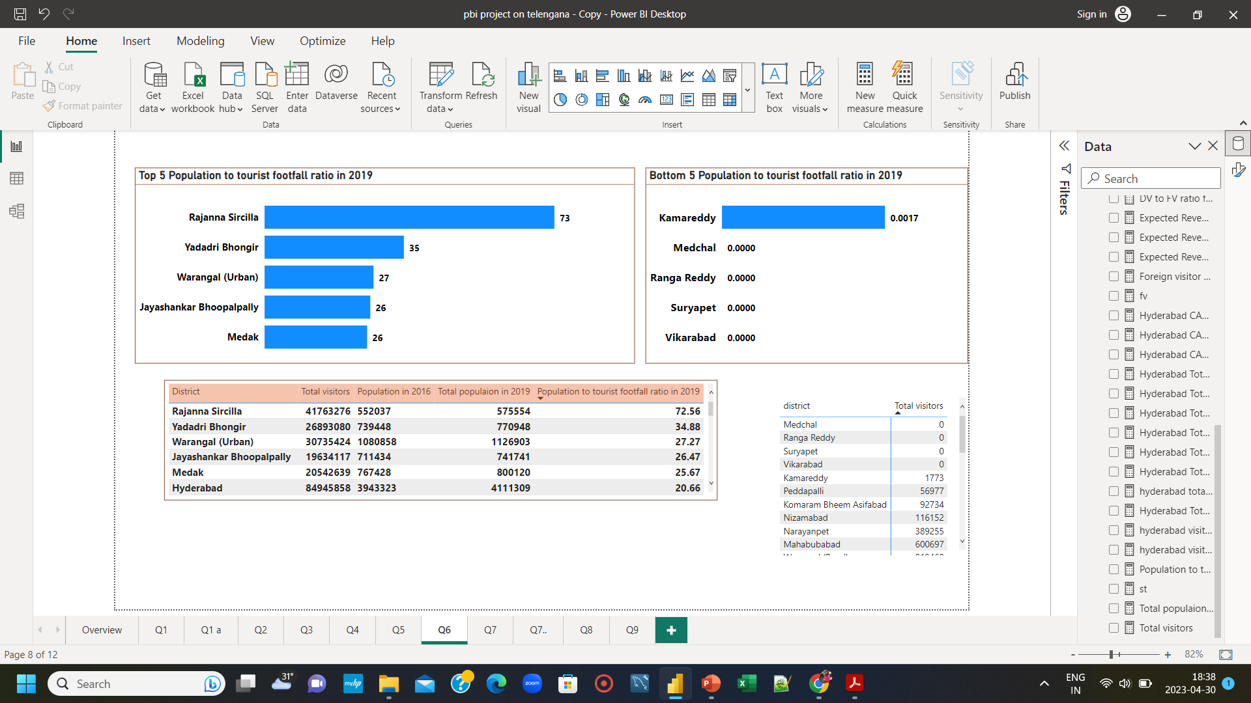
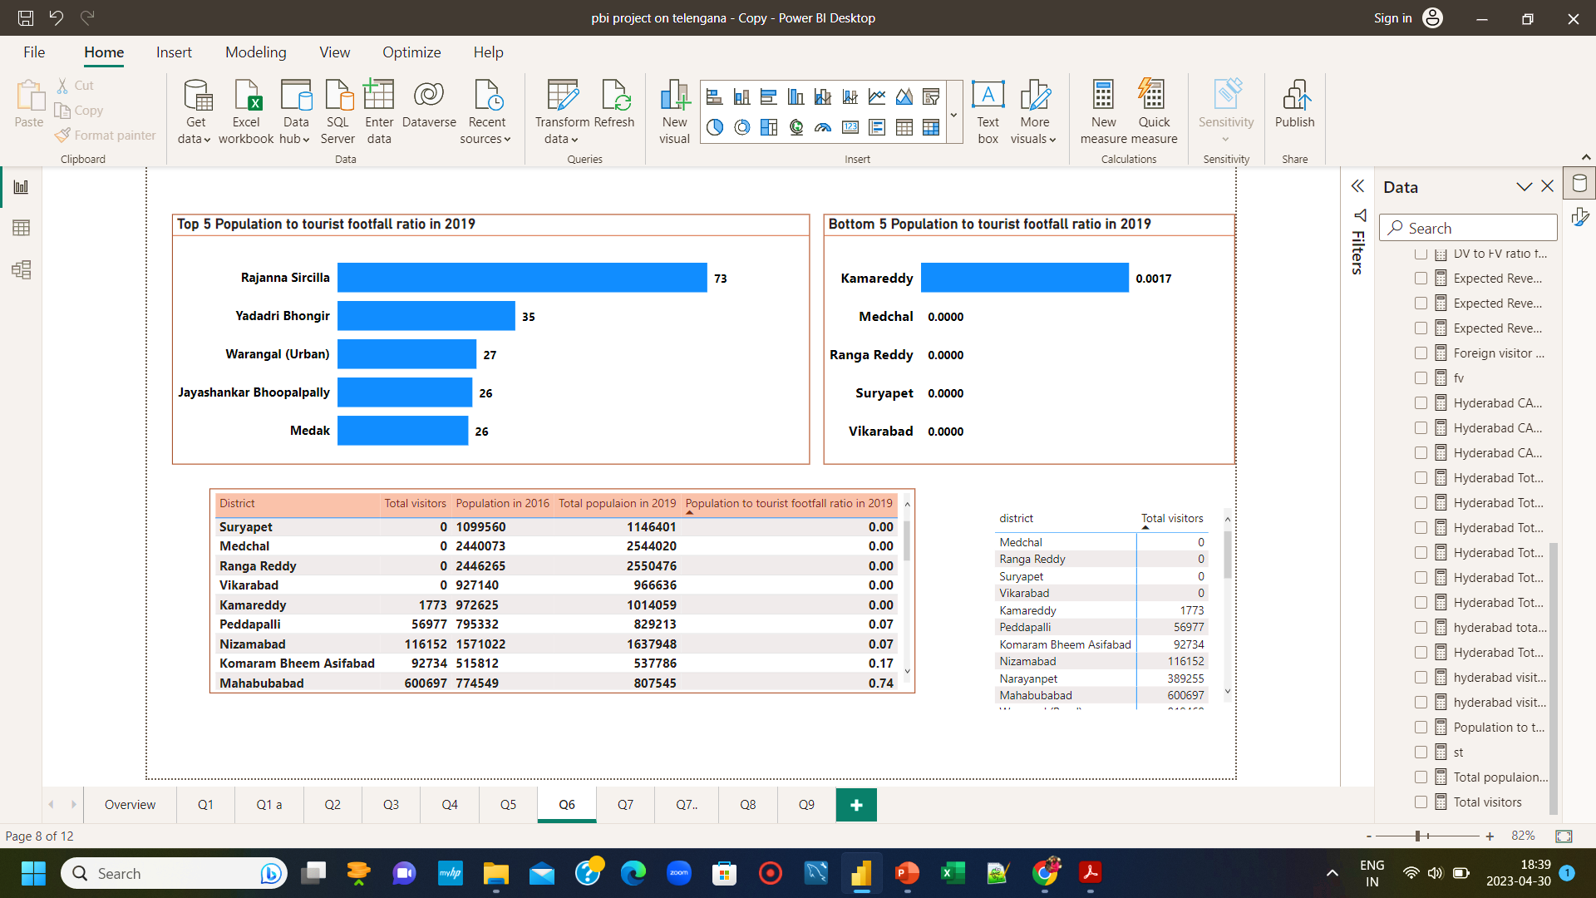
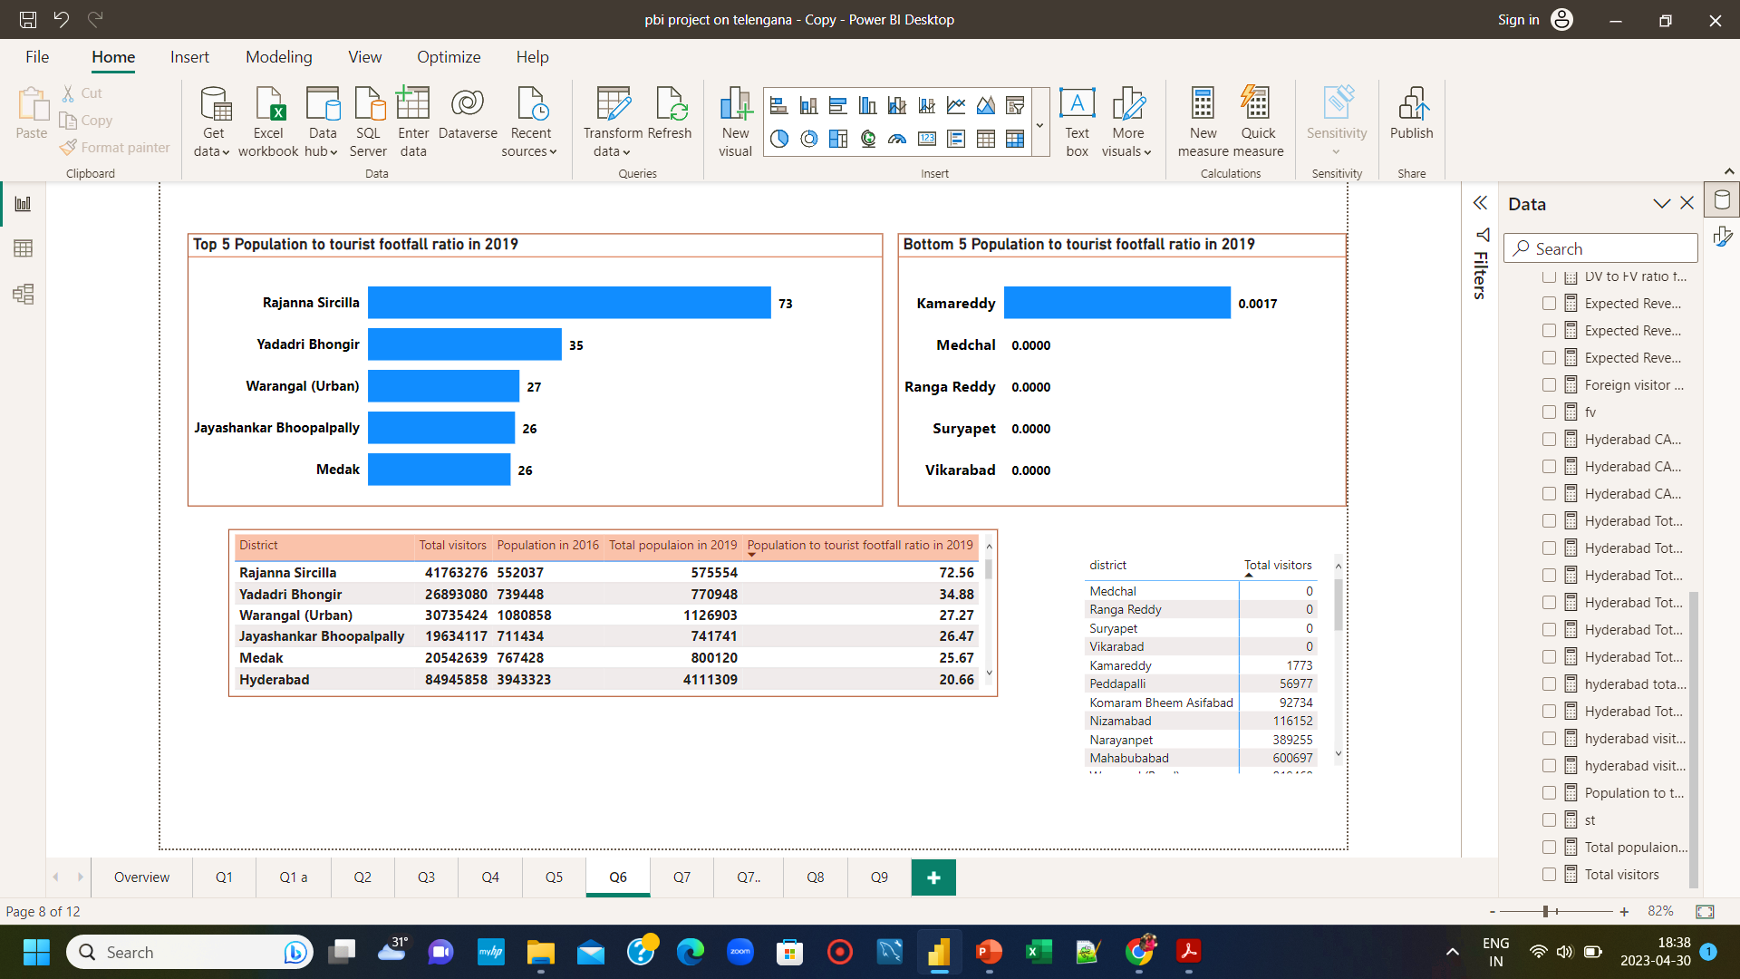
Q6. List top and bottom 5 districts based on population to tourists footfall ratio in 2019
High ratio indicates that large number of tourists are visiting the place relative to the population of that place.
So government should take care of the infrastructure and resources to avoid overcrowding and damage to natural environment.
Low ratio indicates that less number of tourists are visiting the place relative to the population of that place.
So government should focus on these districts to bring more tourists.

Slide 14
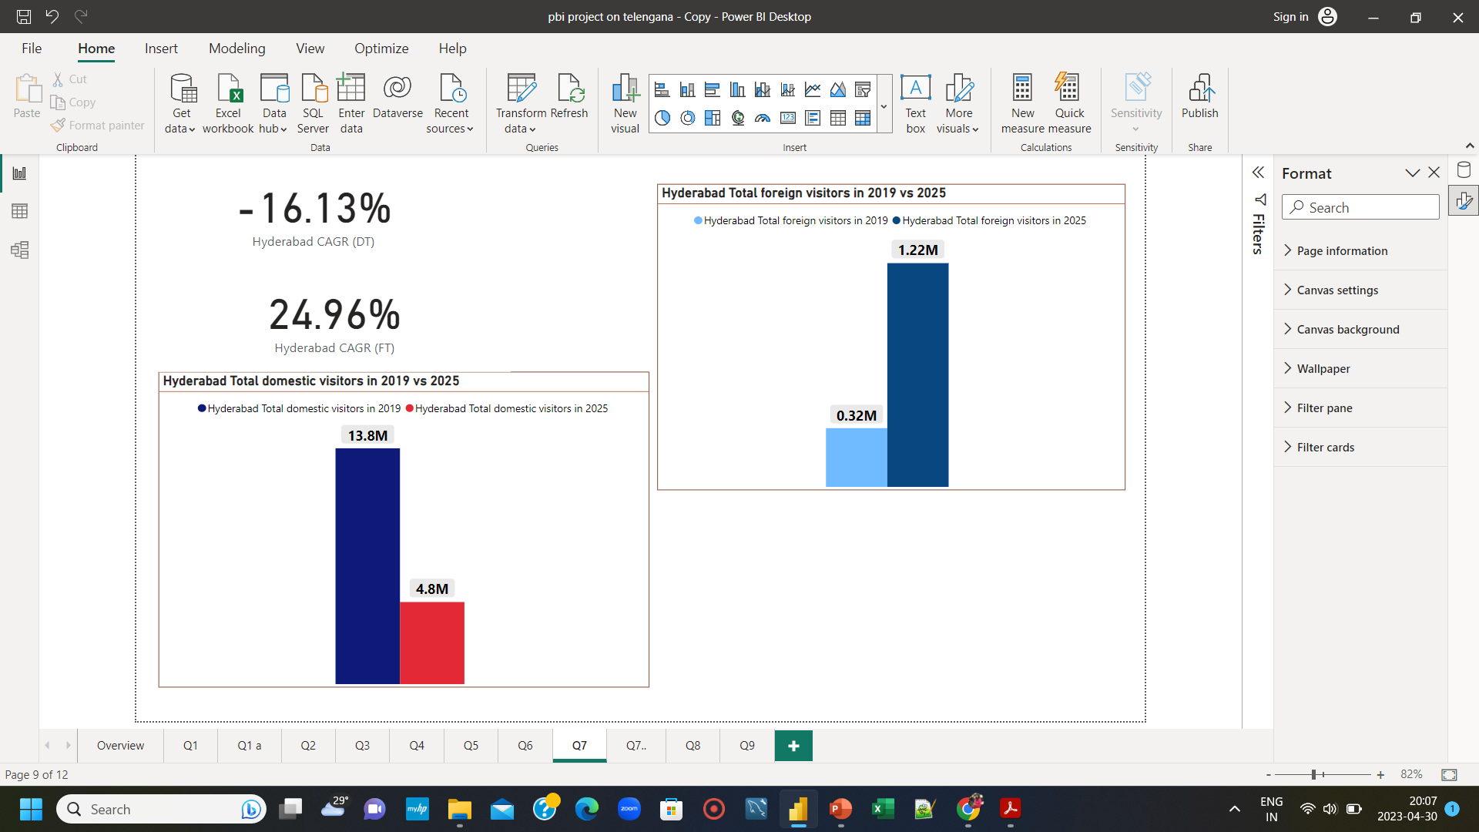
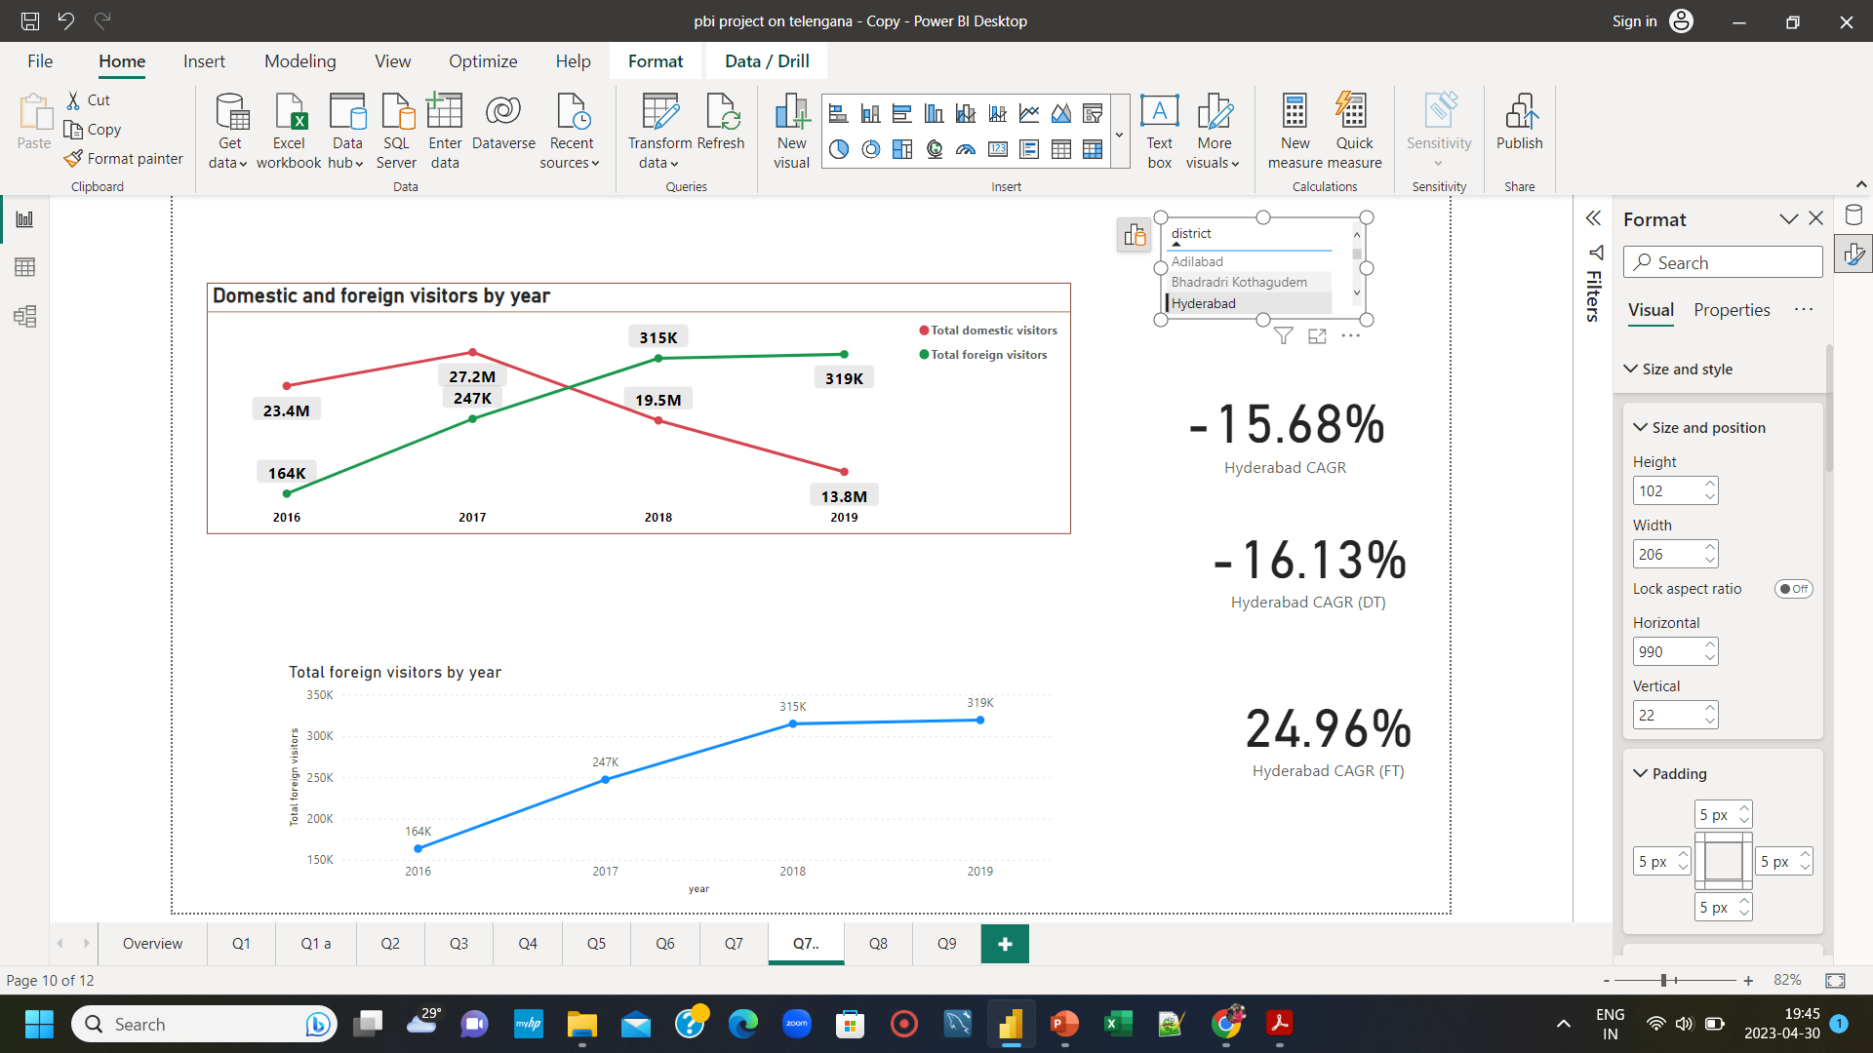
Q7. What will be the projected number of domestic and forest tourists in Hyderabad in 2025 ?
The projected number of domestic tourists in Hyderabad in 2025 will be 4.8 M
(~ 65 % loss from 2019)
The projected number of foreign tourists in Hyderabad in 2025 will be 1.2 M
(~ 281 % increase from 2019)

Slide 15
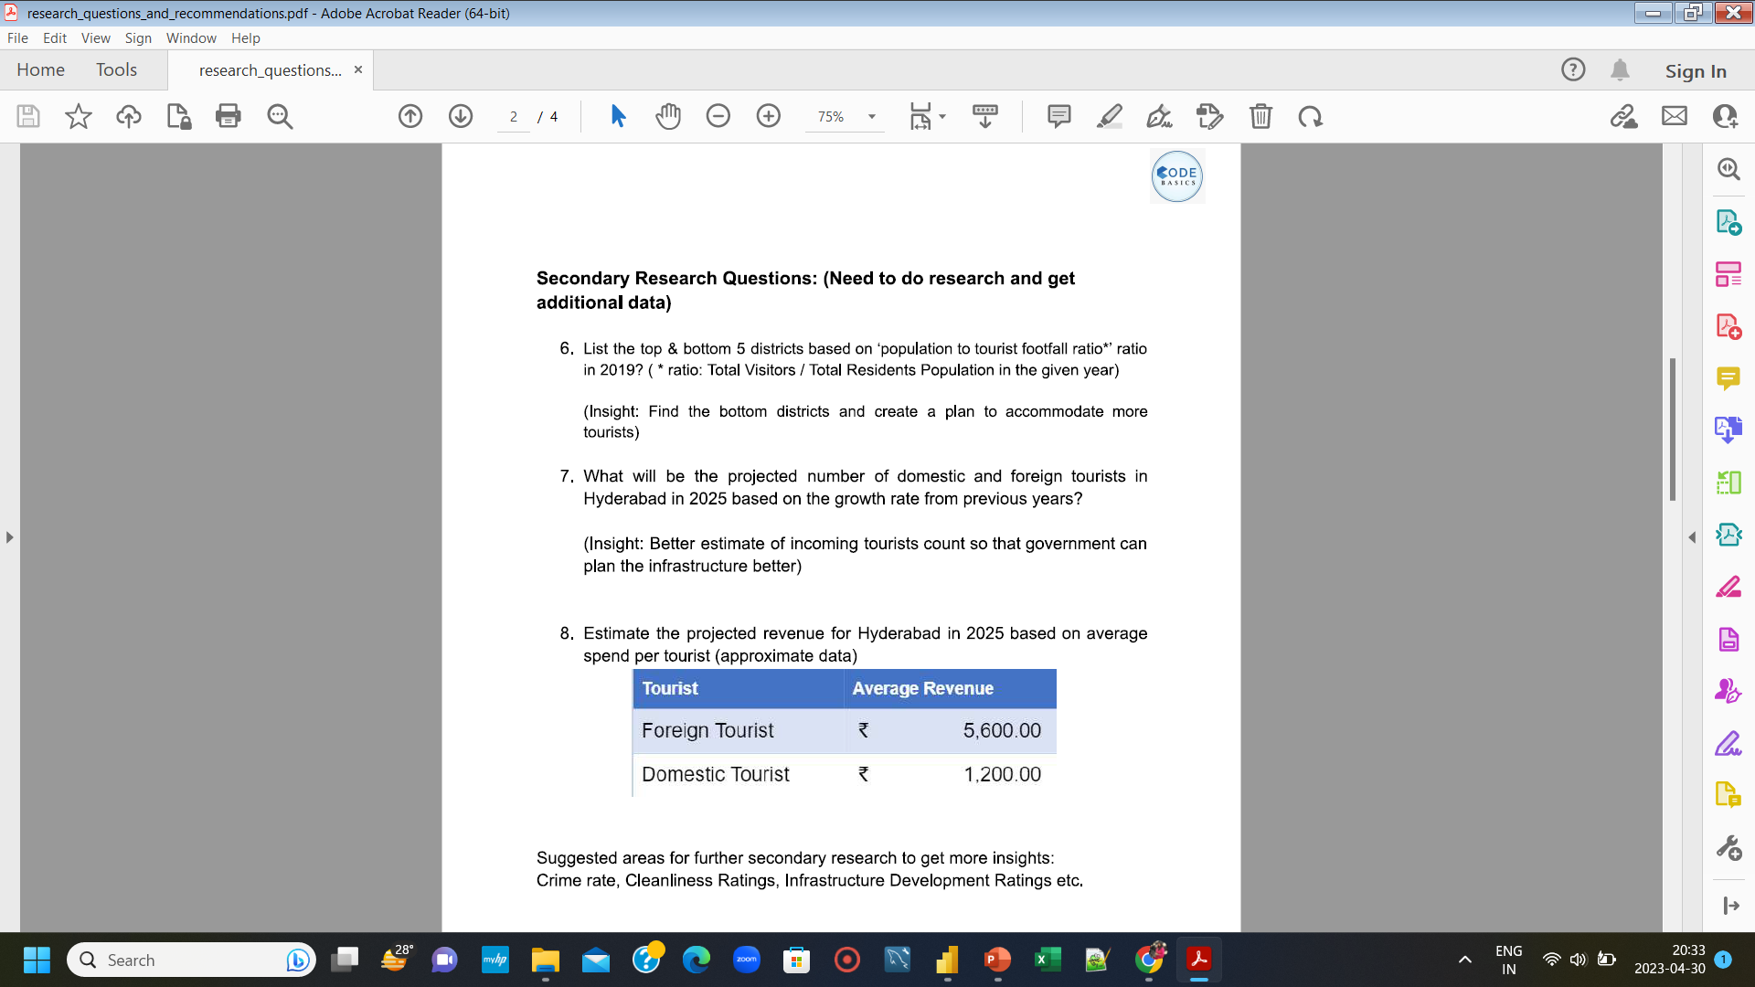
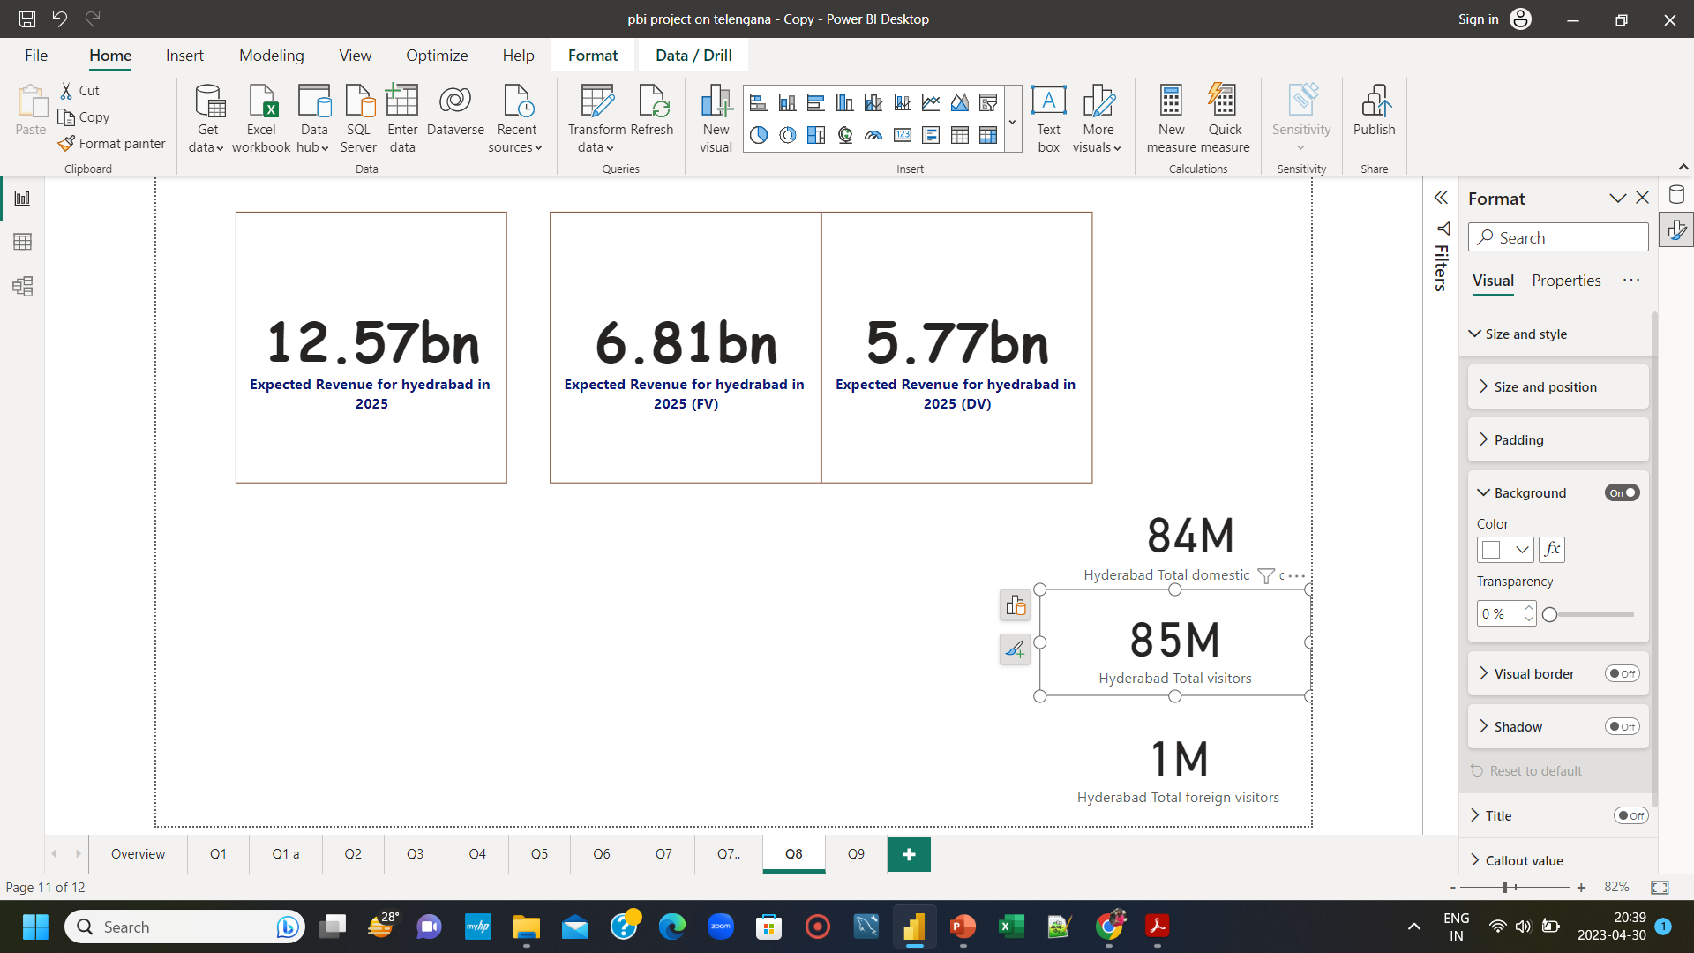
Q8. Estimate the projected revenue for Hyderabad in 2025 based on avg spent per tourist
Projected revenue for Hyderabad in 2025 will be 12.57 bn

Slide 16
Q9. Which district has the highest potential for tourism growth ?
HYDERABAD – the most visited tourist destination in Telangana,
is the district having highest potential for tourism growth
GROWTH DRIVERS
Excellent transport connectivity to all major cities in INDIA
The Hyderabad International Airport (Rajiv Gandhi International Airport)
to connect major international destinations.
Home to renowned academic and research institutes, Universities
Rich cultural heritages
World’s largest film studio Ramoji Film City
Proximity to other tourist destinations
The IT and Pharma hub of INDIA
Medical tourism
Delicious cuisine
City of pearls

Slide 17






Recommendations to improve tourism in HYDERABAD
Conduct Food Festival/Food tour during Ramadan :
The government can organize food festival, food walk/food tour in Hyderabad specially during Ramadan time, featuring the city's diverse cuisine(Ramadan special Hyderabadi Biryani, Nihari, haleem, kebabs, sweets) to attract tourists worldwide.
Organize Culinury competition and cooking workshop :
The government can organize culinary competition, cooking workshops showcasing Hyderabadi traditional dishes. These can attract media attention and help promote Hyderabad's food culture on a larger scale.
Market Hyderabad internationally :
The government can increase its efforts to promote Hyderabad internationally by participating in global tourism fairs, partnering with international travel companies, and launching targeted marketing campaigns in foreign countries.
Improve tourism infrastructure :
The government can invest in improving the city's infrastructure, such as building more roads, bridges, and transportation networks. This will make it easier for tourists to travel within the city and to reach nearby attractions.
Simplify Visa process :
By making the Visa procedures easier, faster, and more transparent, government can encourage more foreign tourists to visit Hyderabad.
Improve medical tourism :
Hyderabad is one of the top five Indian cities where large number of international patients (African countries, Bangladesh, South east Asia) visit for medical treatment. So government can improve air connectivity, improve accomodation facilities, maintain quality treatment.

Slide 18
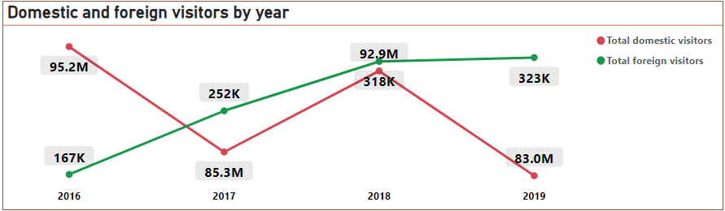
Overview of the trend of tourists arrival in Telangana
(from 2016 to 2019)
With the implementation of e-Tourist Visa, there is a jump in the number of foreign tourists arrival in 2017(~51% increase from 2016), 2018(~26% increase from 2017).
The increasing trend in number of foreign tourists may be attributed to promotion of MICE and medical tourism.
There is considerable fall in number of domestic tourists in 2017 and 2019(~13% decrease from 2016 to 2019).
Source: https://timesofindia.indiatimes.com/city/hyderabad/76-jump-in-foreign-tourist-count-in-2017/articleshow/64132016.cms

Slide 19
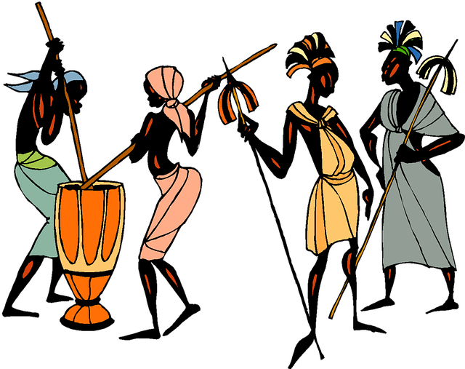
Recommendations to improve tourism in Telangana
Promote Tribal Culture :
Almost 9 % of total population in Telangana is tribal. So government can showcase their unique culture, life, tradition through
arranging Tribal Fair, festival and attract large number of tourists worldwide.
Promote vibrant religious festivals :
--Kakatiya festival
--Deccan Festival
--Bonalu (July Aug) in Hyderabad
--Ugadi
--Ramadan(April-May)
--Bathukamma(sept-oct)
Promote adventure tourism :
To attract young people government can arrange adventure activities as mountaineering, trekking, paragliding, bungee jumping and
river rafting etc.
Promote Art and Crafts of telengana :
-- Nirmal Art (Nirmal town)
-- Silver Filigree (Karimnagar)
-- Dokra Metal craft (Tribal regions)
-- World famous Bronze casting
-- Bonalu Pottery
-- Pochampally Sarees, Gadwal Sarees, Narayanpet Sarees, Siddipet Sarees
To be Continued→

Slide 20

Continued→
Create a strong online presence
Collaboration with social media influencers
Run targeted online advertising campaigns
Use search engine optimization (SEO)
Engage through Social media for customer service
Digital marketing
Promote Digital Marketing :
I appreciate government's effort for creating youtube channel, Instagram page, Facebook page on Telangana tourism. But they are not active in Facebook(since Nov 2020). Youtube channel has only 2.78K subscribers with only few videos since 2018 and Instagram posts are not upto mark also.
In this digital era, ignoring online platforms is a grave error.
To leverage social media platforms in promoting tourism, my suggestions will be :

Slide 21
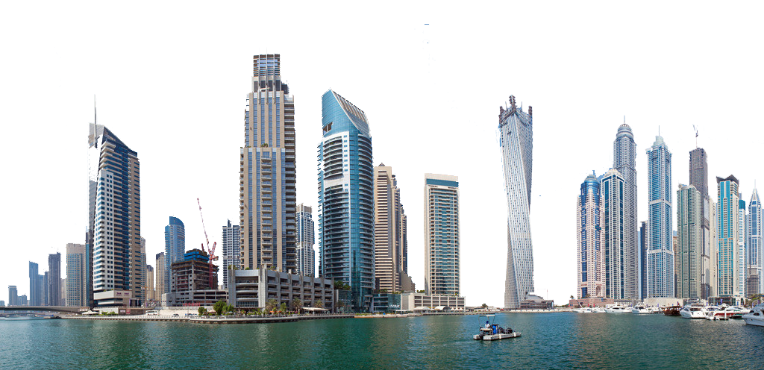
Dubai has made itself a business hub and enjoy massive business tourism.
Can Hyderabad emulate the Dubai model ?
Dubai’s business model:
From the barren desert to world’d 28th wealthiest city(third quarter of 2022) Dubai has become such an important business hub that out of the 500 biggest companies in the world, 140 companies have their headquarters in this tiny city Dubai. Their top three key growth drivers are :
Strategic location for air transportation to connect most important regions of the world.
2) Jebel Ali port, which is 9th busiest port in the world that provide important logistic service and have advanced storage and cooling facilities specially for perishable products.
3) Created an irreplaceable, irreversible, global business ecosystem
To be Continued→

Slide 22
Continued→
Similarities between Hyderabad and Dubai as business hub
Strategic Location:
Both cities are strategically located, making them important trading hubs. Hyderabad is located in the heart of India, making it a gateway to the South Asian market, while Dubai is situated at the crossroads of Asia, Europe, and Africa, making it an important hub for global trade.
Infrastructure:
Both Hyderabad and Dubai have invested heavily in infrastructure development, including modern airports, road networks, and high-speed internet connectivity. This has helped both cities to attract business investments and establish themselves as modern business centers.
Business-friendly policies:
Both Hyderabad and Dubai have implemented policies to attract foreign investment and encourage business growth. For example, Dubai has a liberal tax regime, which includes zero corporate and personal income taxes, while Hyderabad has implemented policies to simplify business registration and licensing procedures.
To be Continued→

Slide 23
Continued→
Differences between Hyderabad and Dubai as business hub
While Hyderabad has the potential to grow as a business hub, there are several factors that could limit its growth in comparison to Dubai. These include :
Limited International Connectivity:
While Hyderabad is well-connected to other major cities in India, it has limited international connectivity. Currently, there are direct flights from Hyderabad to a limited number of international destinations, which could limit its appeal to businesses looking for a global hub.
Political Instability:
While Hyderabad is generally considered a stable city, the broader political environment in India can be volatile at times. This can make it more difficult for businesses to operate, particularly those that rely on stable political and economic conditions.
Infrastructure:
While Hyderabad has made significant investments in infrastructure development in recent years, it still lags behind Dubai in terms of its overall infrastructure. For example, Hyderabad's airport, while modern, is much smaller than Dubai's, and its road network is not as developed. This could make it more difficult for Hyderabad to attract large businesses and multinational corporations.
Size, Population and Culture :
Dubai is a much larger city than Hyderabad, with a population of over 3 million, while Hyderabad has a population of around 10 million. This makes Dubai a more attractive market for larger businesses, while Hyderabad is better suited for startups and mid-sized enterprises. Also Dubai is a more cosmopolitan city, with a diverse population made up of people from around the world. In contrast, Hyderabad has a more traditional culture, with a strong emphasis on family and community.
To be Continued→

Slide 24
Continued→
Can Hyderabad emulate the Dubai model ?- the SCOPES
Hyderabad can learn from Dubai's success and take steps to create its own model that is tailored to its strengths to grow as a business hub. Some of these include:
Focus on Diversification:
Dubai has achieved success by diversifying its economy, moving beyond oil and gas to sectors such as tourism, finance, and logistics. Hyderabad can emulate this by continuing to invest in its technology industry while also diversifying into other sectors such as healthcare, biotech, and renewable energy.
Improve Infrastructure:
Dubai has world-class infrastructure, which has helped it attract investment and become a business hub. Hyderabad can emulate this by continuing to invest in its infrastructure, including its airports, roads, and public transportation systems.
Create a strong irreplaceable business ecosystem:
Hyderabad has a thriving start-up ecosystem, with several incubators, accelerators, and co-working spaces. The government of Telangana has implemented several initiatives to support start-ups, such as the T-Hub innovation center. Also they have implemented several policies to attract investment. For example, the Telangana State Industrial Project Approval and Self-Certification System (TS-iPASS) simplifies business registration and licensing procedures, and the Telangana State Industrial Infrastructure Corporation (TSIIC) provides land and infrastructure for industrial development. These together will help Hyderabad to create a irreplaceable strong business ecosystem.
Overall, Hyderabad has several opportunities to grow as a business hub, particularly in the technology industry and as a start-up ecosystem. Its strategic location, pro-business policies, and infrastructure development provide a strong foundation for further growth and investment.
This business tourism(MICE) will create more lucrative market opportunities for the hospitality industry, airlines, transportation, and other related businesses.

Slide 25

Learn from Kerala tourism model
The marketing campaign to increase Brand Recall Value of kerala made Kerala-God’s own country today a world famous tourist destination(9th in “World’s Greatest places 2022) .
Likewise Telangana can curate its marketing campaign is such a way that when someone thinks of travelling to a particular place, by default Telangana must be their obvious choice.
By choosing their unique and poweful attributes like natural treasue/historical heritage sites/food, Telangana can create a brand and promote aggressively the state as “Must Visit Place” in all the seasons.

Slide 26

Codebasics Resume Project Challenge link: https://codebasics.io/challenge/codebasics-resume-project-challenge
My Github link : https://github.com/MadhupaSamanta/Telangana-Tourism-Project-Codebasics-resume-project-challange.git
LinkedIN : https://www.linkedin.com/in/madhupa-samanta-a94a2917b/
Presentation by : Madhupa Samanta
Data Analyst

